Slide 1
第7讲 关系数据库概念设计（E/R模型）
——ENTITY-RELATIONSHIP(ER) MODULE

Slide 2
TODAY’S LECTURE
Conceptual design for database with E/R Diagram（E/R图）
实体/联系图进行概念设计
Convert E/R designs to relational DB designs.
将E/R设计图转化为逻辑结构（关系模式）

Slide 3
我们曾经的工作数据库
simple movies database
  Movies(title,year,length,movieType,studioname,producerC)
  movieStar(name,address,gender,birthdate)
  StarIn(movietitle,movieyear,starname)
  MovieExec(name,address,cert,netWorth)
  Studio(name,address,presC)
以上关系模式是如何设计出来的？
这样的设计合理吗？

Slide 4
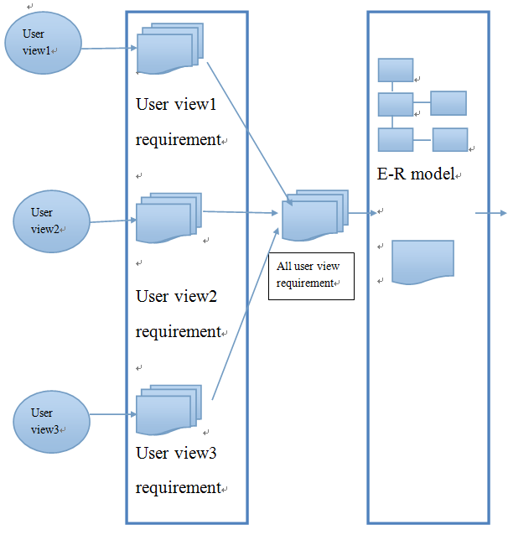
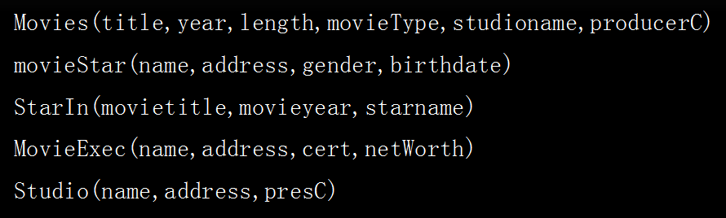
CENTRALIZED APPROACH
逻辑设计
概念设计

Slide 5
DESIGN
ideas
概念设计
High level design
逻辑设计
Relational database schema
物理设计
Relational DBMS

Slide 6
DATABASE DESIGN METHODOLOGY设计方法学
直接进行概念设计（E/R 模型）
  Identify all Entities and Relationships, and describe them using so-called E/R diagrams
（E/R图来刻画实体世界）
  Convert the E/R model to a number of relation schemas
（将E/R图转化为关系模式）
用规范化理论优化设计
  Eliminate the redundancy by splitting relations. This process is called normalization
  （规范化理论来消除冗余）

Slide 7
E/R图-实体/联系图

Slide 8
PURPOSE OF E/R MODEL
实体/联系图目的
Make blueprints before the database is constructed
构造数据库之前先制作“蓝图”-实体/联系图

Slide 9
ENTITIES AND ENTITY SETS
实体和实体集
Entity （实体）= “thing” or object of some sort.
Eg. 电影 ”Harry Potter and the Order of the Phoenix”,
or影星 “Daniel Radcliffe”
Entity set（实体集） = a set of entities of the same type that share the same properties.具有相同属性的实体的集合
Eg. 所有电影, or 所有影星

Slide 10

ATTRIBUTE（属性）
Entity Attribute（属性） = property of (the entities of) an entity set.
Example :
  Entity set （实体集）“movies” might be given attributes title, year, movietype, length
  Entity set （实体集）“star” might be given attributes name,address

Slide 11
HOW TO IDENTIFY ENTITIES
如何唯一确定一个实体
Identifier/key（键） = A set of attributes（属性或属性组） whose values uniquely identify an entity (唯一确定一个实体)in its entity set .
Example: the name attribute in “star” entity set uniquely identify the star, so attribute “name” is the key
如演员名字唯一确定一名演员，“名字”属性就是键

Slide 12
RELATIONSHIPS（联系）
Relationship （联系）= connections between two or more entity sets两个或多个实体集间的联系
演员“Daniel Radcliffe” 在电影 ”Harry Potter and the Order of the Phoenix”里演出
“Disney”电影公司发行了电影”frozen”

Slide 13
RELATIONSHIPS（联系）
Example :
  Relationship stars-in connecting Entity sets “stars” and “movies”(represent the fact that some star stars in some movies)
  Relationship owns connecting Entity sets “movies” and “studio”(represent the fact that some studios issues some movies)

Slide 14
ENTITY-RELATIONSHIP DIAGRAMS（E/R图）
In an entity-relationship diagram:
  Entity set实体集 = rectangle.矩形
  Attribute属性 = oval.椭圆
  Relationship联系=diamond.菱形
  Edges connect an Entity to its attributes and also connect a relationship to its entities
  将实体集和属性用边相连，将实体集和联系也用边相连
  we underline the attributes in its primary key
  作为主键的属性或属性组用下划线标记

Slide 15
year
length
name
addr
Title
movietype
stars
表演
star in
movies
发行
own
studio
address
name

Slide 16
DISCUSSION (2 MINUTES)
In our imaginary movies database, add new entity set and relationships to reflect the fact that some persons manage studios

Slide 17
year
length
name
addr
Title
movietype
stars
star in
表演
movies
own
发行
studio
run
管理
presidents
address
name
cert
address
name

Slide 18
FROM E/R DIAGRAMS TO RELATIONAL DESIGNS
（E/R图转化为关系模式）
4.5

Slide 19
General rules:实体集→关系
Turn each entity set(实体集) into a relation（关系） with the same set of attributes
每个实体集转化为一个关系，关系属性就是实体集属性
name
addr
star
name | addr
carrie fisher | 123 maple st.
mark hamill | 123 maple st.
harrison ford | 789 palm dr
star
Star(name,addr)
Instance of Entity

Slide 20
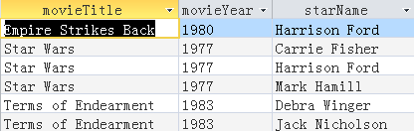
General rules:联系→关系
Relationships -> relations whose attributes are only:
  The keys of the connected entity sets.
  Attributes of the relationship itself.
每个联系转化为一个关系，属性由 该联系所连接的所有实体主键及自身属性构成
stars in
movie
star
starsIn(movietitle ,movieyear ,starname)

Slide 21
DISCUSSION (2 MINUTES)
year
length
Title
own
发行
movietype
studio
movies
name
address
Convert the design of movie database into relational schema
将概念设计以General rules转化为关系模式
  studio(name,address)
  movies(title,year,length,movietype)
  own(title,year,studioname)

Slide 22
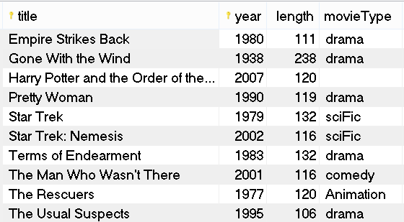
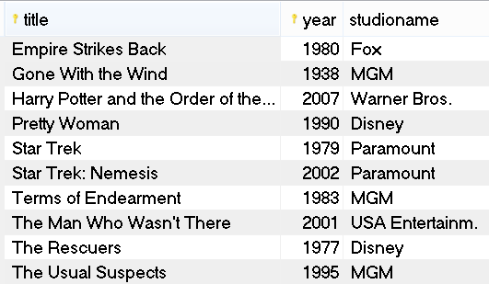
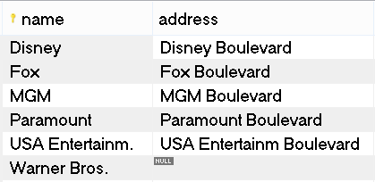
发现问题？
movies
own
studio

Slide 23
MULTIPLICITY OF BINARY E/R RELATIONSHIPS
二元联系的多样性

Slide 24
WHY MULTIPLICITY
In general ,a binary relationships can connect any members from one entity set to another.
二元联系能将一个实体集中任意数目的实体与另一实体集的任意数目的实体相连接
But there should be restrictions sometimes.
但实际问题上会有约束

Slide 25
MULTIPLICITY（联系的多样性）
The multiplicity of a binary relationship(involving two entity sets) can be categorized as many-one , one-one , many-many（二元联系的多样性可以分为多对一、一对一、多对多三种）

Slide 26
MANY-ONE RELATIONSHIPS
多对一联系
many-one relationship多对一联系 :
Each entity of the first set is connected to at most one entity of the second set.
  Example:a studio may own many movies, each movie is owned only by one studio.
n
own
1
movie
studio

Slide 27
ARROWS IN MANY-ONE RELATIONSHIPS
箭头 指示
In ER diagram, many-one relationship is dictated by an arrow pointing to the one end
多对一关系图中，箭头指向“1”方的实体集
own
movie
studio

Slide 28
In a binary many-one relationship, it is different between at most one and exactly one
多对一联系中，“一”联结的实体可以是‘最多一个实体’，也可以是‘刚好一个实体’
exactly one
at most one
own
movie
studio

Slide 29
ROUND ARROWS IN MANY-ONE RELATIONSHIPS圆形箭头
In order to distinguish this, Arrow is replaced by round arrow in the ER diagram if there is exactly one entity to be connected
圆形箭头指向‘刚好一个’对应的实体集
own
movie
studio

Slide 30
COMBINING RELATIONSHIP WITH RELATIONS合并原则
从E到F的多对一的联系R，且圆形箭头指向F, E和R可以合并
OK to combine E with R into a new relation , with
  1.All attributes of E; 2.The key attributes of F ;3. Any attributes belonging to relationship R
studio
owns
movies

Slide 31
COMBINING RELATIONS
Example:
movies(title,year,length,movietype) ， studio(name, addr)
owns(title,year, name)
after Combining:
  movies1(title,year,length,movietype, studioname).
  studio(name, addr)
studios
owns
movies

Slide 32
ONE-ONE RELATIONSHIPS一对一联系
one-one relationship :each entity of either entity set is related to at most one entity of the other set.
1
runs
1
studio
president

Slide 33
REPRESENTING “ONE-ONE”
Show a one-one relationship by arrows entering both entity sets.
studio
runs
president

Slide 34
EXAMPLE: ONE-ONE RELATIONSHIP
Consider earliest-movie between movie and studio.
Each movie is owned by exactly one studio
Each studio has at most one movie
Earliest
-movie
movie
studio

Slide 35
MANY-MANY RELATIONSHIPS多对多联系
many-many relationship : an entity of either set can be connected to many entities of the other set
E.g., a movie has many stars; a star may play in many movies

Slide 36
IN PICTURES:
many-many

Slide 37
PRACTICE
Add arrows to show the multiplicity of relationships in E/R diagram
star in
movie
star
own
studio
earliest
president
run

Slide 38
DISCUSSION
year
length
name
addr
Title
genre
many
star in
many
stars
movies
many
president
one
run
one
one
own
studio
cert
name
addr
name
address

Slide 39
SELF RELATIONSHIPS
Self relationships = relationships between the same entity sets.
Sequel-of
movies
movies(original)

Slide 40
ROLES IN E-R DIAGRAM
in the self relationship , each line to the entity set represents a different role that the entity set plays.
Label the edges between the relationship and the entity set with names called roles.
Sequel-of
sequel
original
movies

Slide 41
CONVERSION OF SELF RELATIONSHIP
Rename the attributes to avoid name duplication
sequel(title1, year1,title2,year2)
title1 | year1 | title2 | year2
Kung Fu Panda | 2008 | Kung Fu Panda | 2011
Kung Fu Panda | 2008 | Kung Fu Panda | 2016

Slide 42
EXAMPLE: SELF RELATIONSHIP
Relationship Set
Husband Wife
Bob Ann
Joe Sue
… …
Married
husband
wife
stars

Slide 43
MULTIWAY RELATIONSHIPS
multiway relationship =relationship connecting two or more entity sets.

Slide 44
MULTIWAY RELATIONSHIPS
Suppose a studio has contracted with a particular star to act in a particular movie.
star
contract
movie
studio

Slide 45
ATTRIBUTES ON RELATIONSHIPS
Sometimes it is useful to attach an attribute to a relationship.
Think of this attribute as a property of tuples in the relationship set.

Slide 46
EXAMPLE: ATTRIBUTE ON RELATIONSHIP
Salary can’t be determined by any entity set that the relationship connects
salary
star
contract
movie
studio

Slide 47
CONVERT MULTIWAY RELATIONSHIP TO BINARY RELATIONSHIP
view the relationship as a new entity set.
Connect the new entity set to all entity sets that involved in the multiway relationship.

Slide 48
作业
课后完成p81,4.1.1-4.1.5下节课讨论

Slide 49
CONSTRAINS IN THE E/R MODEL
课后思考

